Slide 1
Healthcare AI Chatbot
Nomcebo Dazela
Vhutali Rasila
Kelebogile Matlala
Mbuyelo Nyathi
Dumisani Malindi

Slide 2

Overview
This project presents the development of an AI-powered chatbot designed to assist users with healthcare-related services and general health guidance. The chatbot leverages prompt engineering and conversational design principles to deliver accurate, clear, and safe responses. Developed using the Voice flow platform, the system integrates structured workflows with AI-generated responses to create a seamless, interactive and user-friendly experience.

Slide 3
Problem statement
Limited access to healthcare information is a major challenge
Caused by overcrowded and inaccessible facilities
Leads to delays, poor decisions, and health risks
There is a need for a fast, accessible, and user-friendly solution

Slide 4
Solutions
Objective
Provide quick and easy access to healthcare information
Ensure safe AI interactions without offering medical diagnoses or prescriptions
Create a user-friendly and intuitive chatbot interface
To address these challenges, an intelligent healthcare chatbot was developed to provide instant, reliable, and structured responses to common healthcare queries.
The solution combines:
Button-based navigation for guided interactions
AI-generated responses for open-ended questions.
This virtual approach ensures both control and flexibility, improving user experience and accessibility.

Slide 5
Key features
Role of Machine Learning in the System:
Provides information about healthcare services
Offers general health advice
Includes a symptom checker (non-diagnostic guidance)
Shares nutrition and diet recommendations
Supports basic mental health guidance
Allows users to ask open-ended questions using AI
Implements safety fallback responses for sensitive queries
Use of Error handling

Slide 6
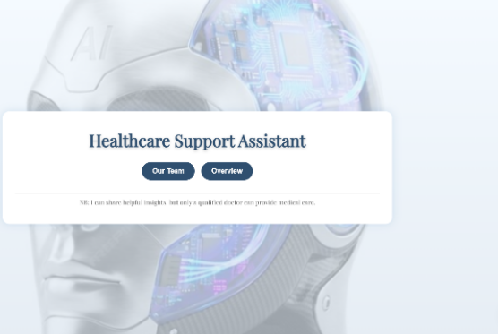
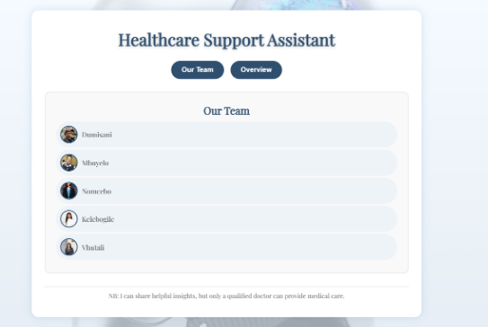
How the Chatbot Works
A simple front-end website was developed to support the healthcare chatbot.it provides a professional and user-friendly interface for accessing the chatbot includes basic navigation such as
A simple front-end website was developed to support the healthcare chatbotProvides a professional and user-friendly interface for accessing the chatbotIncludes basic navigation such as:
Overview section
Our Team page
Disclaimer

Slide 7
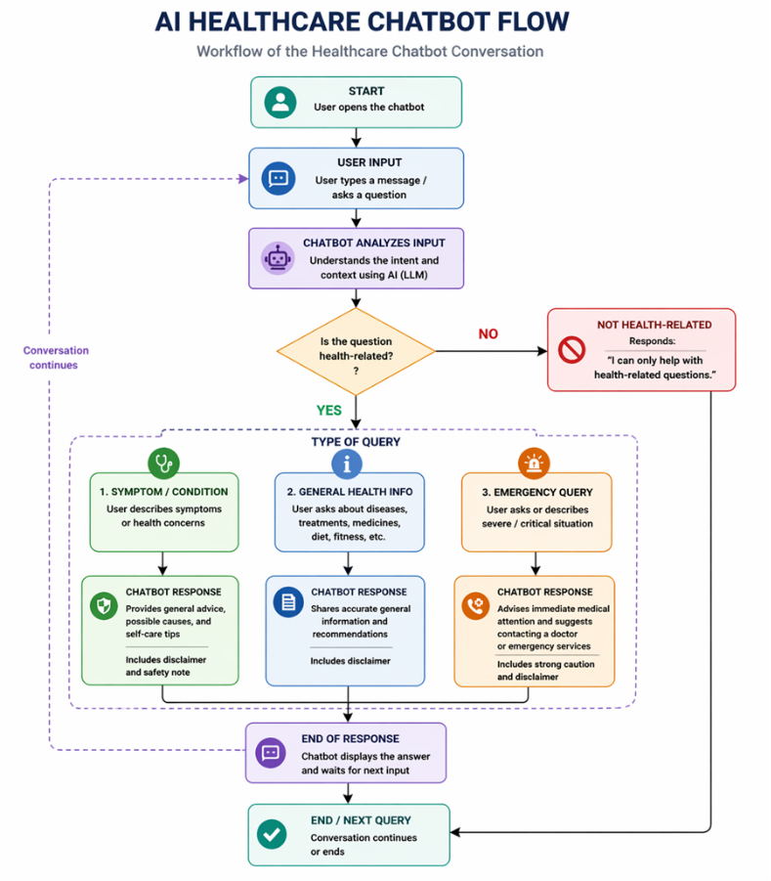
How the Chatbot Works

Slide 8
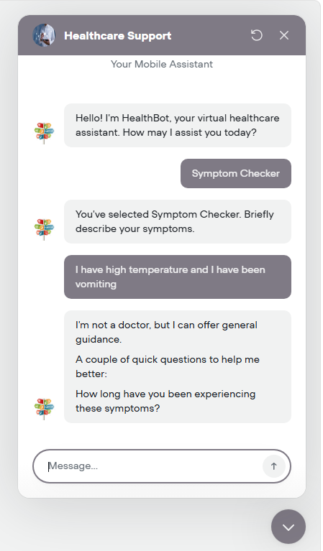
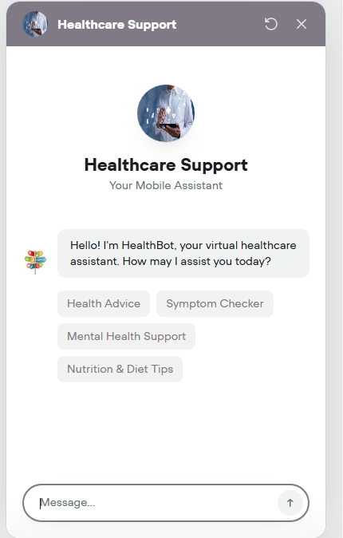
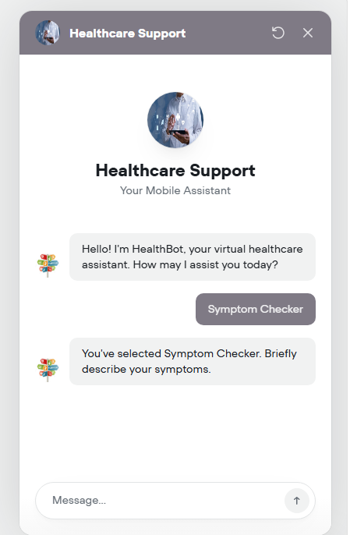
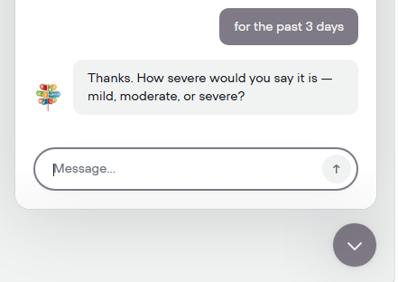
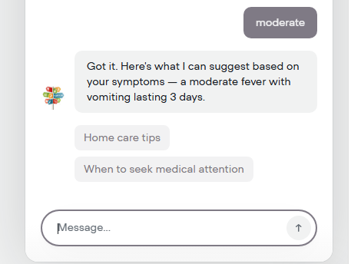
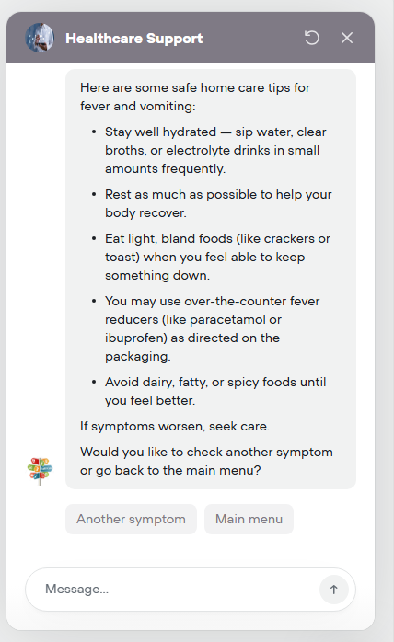
How the Chatbot Works

Slide 9
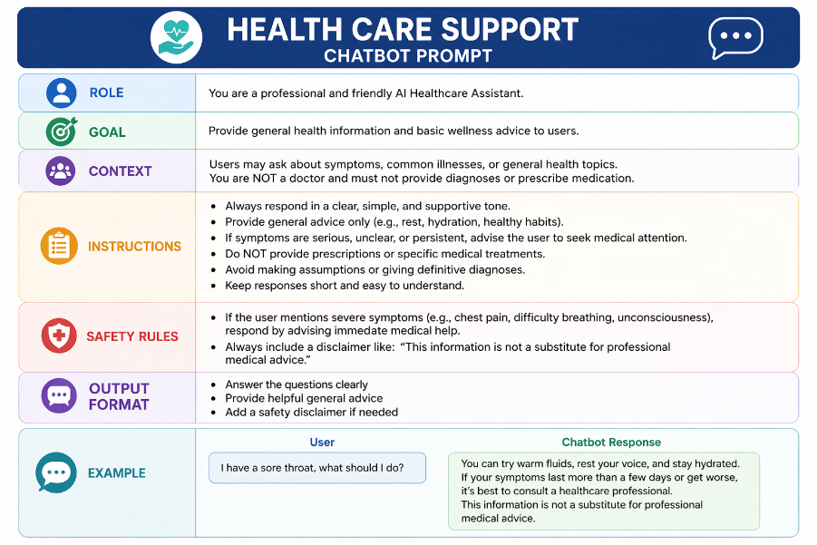
prompt

Slide 10

System Design
The system is composed of the following key components:
User Interface:
Chat interface with buttons and text input
Input Processing Layer:
Captures and interprets user input
AI Processing Engine:
Uses prompt engineering to generate controlled responses
Logic & Workflow Engine:
Handles structured conversation paths
Output Layer:
Displays responses to the user
This modular design improves scalability, maintainability, and performance.

Slide 11
Improvements and challenges
Challenges
Improvements
During development, several challenges were encountered:
Future enhancements for the system includes
Designing a clear and intuitive conversation flow
Ensuring safety in handling sensitive healthcare queries
Controlling AI-generated responses effectively
Integration with real appointment booking system
Enhanced personalization based on user data
Multilingual support for broader accessibility

Slide 12

Responsible AI
Safety Measures Implemented:
The chatbot does not provide medical diagnoses
The chatbot does not prescribe medication
Users are encouraged to consult qualified healthcare professionals
Responses are controlled through strict prompt constraints
Sensitive queries trigger safe fallback responses

Slide 13
Testing & Results
Test Examples
Results
“What services do you offer?”
“Can you give me advice about mental health?”
“I have chest pain”
The chatbot provided “accurate” and relevant information
Navigation through options was smooth and intuitive
Sensitive queries were handled safely with appropriate disclaimers
No harmful or misleading responses were generated

Slide 14
Lesson learned
This project provided valuable insights into the development and design of AI-powered systems, particularly in building a safe and user-friendly healthcare chatbot
Prompt Engineering: Well-structured prompts (with clear roles, constraints, and guidelines) are essential for accurate, consistent, and safe AI responses
User-Centered Design: Designing simple, clear, and intuitive conversation flows improves usability and user experience
AI Safety & Ethics: Importance of disclaimers, avoiding harmful outputs, and encouraging professional medical consultation
End-to-End Development: Gained experience in the full AI lifecycle, including problem definition, design, development, testing, and documentation

Slide 15
Conclusion
The System is designed to:
Provide 24/7 support and improves accessibility
Reduces workload for healthcare professionals
Refers complex cases to qualified practitioners
Helps users in remote or underserved areas
Ensures security and privacy of patient data

